Slide 1
Play DECIDE:
Gaming Social Sciences
Milena Wuketich, Erich Grießler, Alexander Lang (Institute for Advanced Studies Vienna, IHS)
Brigitte Gschmeidler, Jochen Stadler (open science)
Matthias Kopp (Democracy Centre Vienna)

Slide 2
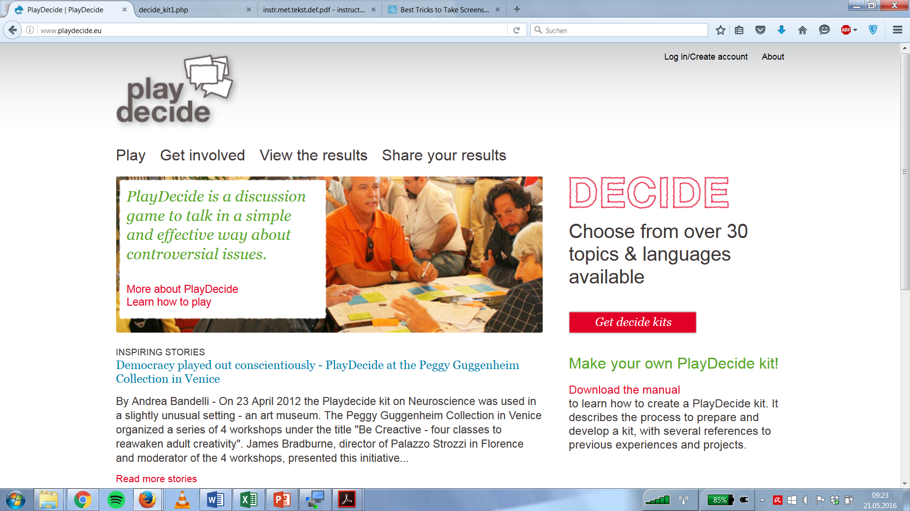

Slide 5
Thank you!
wuketich@ihs.ac.at

